Slide 1
Online News Article Popularity Classification
Aditya Kumar
Sasank Reddy
Nischay Sai

Slide 2
Background
Advent of internet → Information boom
Defining popularity
Predicting popularity
Utility – Preemptive tweaking
Notes:
With the help of the Internet, online news can be instantly spread around the world. Social media, such as Twitter and Facebook, has made it easy for people to read and share news online.
Popularity of an article is usually determined by its number of readers, likes, or shares. In our dataset, we use shares as the metric to measure popularity. In the online news industry, content providers or advertisers benefit greatly from the ability to accurately predict the popularity of content before it is published. Thus, it is interesting and meaningful to use machine learning techniques to predict the popularity of these articles.
Popularity of news depends upon various features like usage of different keywords, relevance to a trending topic, perhaps even the day the article is published. It is necessary to know what makes one online news article more popular than another.
Utility – There are two main popularity prediction approaches: those that use features only known after publication and those that do not use such features.
The dataset that we have used consists of features that are known before publication.
Though the prediction performance is usually low in the latter case, it is of more value addition to authors and content creators.
As a preemptive approach, articles predicted to be unpopular can be enhanced to promote popularity by tweaking identified key features. This can greatly benefit authors of articles, content providers, advertisers, and even politicians

Slide 3
Table of Contents
01
02
03
Data Background
Exploratory Data Analysis
Data Preprocessing
About the Data.
Feature Engineering. Data Interpretation.
Data Balancing.
04
05
Prediction Model
Concluding Notes
Logit Regression. Confusion Matrix. Random Forest Classifier etc.
Model Summary.

Slide 4
Data Background

Slide 5
About the Data
What – ​News Articles data from Mashable Blog site
​
How Many – 39,000+ Articles & 61 features
​
When – January 7, 2013 – January 7, 2015
Where – Obtained from UCI Machine Learning Repository
Why – To classify an article as popular or unpopular prior to publication
Notes:
Machine Learning Repository of University of California at Irvine provides a dataset with a heterogeneous set of features about articles published by Mashable, a popular blogs site in the world, during a period of two years. A copy of this dataset is taken from Kaggle instead, due to difficulties in downloading from the original source. This dataset consists of 39,664 observations for 61 different variables, with the number of shares as our dependent variable.

Slide 6
Understanding the Data
Extracted features
NLP features
Encodings and decoding
Mashable dependent features
Target variable
Shares convergence
Notes:
Extracted features like- keywords, digital media content(e.g., images, video), earlier popularity of news referenced in the article; average number of shares of keywords prior to publication; and natural language features like sentiment polarity and latent dirichlet allocation.
We didn’t deep dive into these NLP features too much but understood the overall gist.
The Latent Dirichlet Allocation (LDA) algorithm was applied to all Mashable articles in order to first identify the five top relevant topics and then measure the closeness of current article to such topics. To compute the subjectivity and polarity sentiment analysis, pattern web mining module was used. Subjectivity measures how subjective the article is – in terms of personal opinions vs facts. It ranges from 0-1 with a higher score indicating more personal opinions and lower indicating factual inclination. Polarity sentiment analysis indicates the sentiment – negative, neutral and positive. It ranges from –1 to 1.
Some of the attributes in the dataset have already been encoded for machine learning. However, we will decode it into a single column for visualization purposes. Like data_channel and publish_day. Data_channel are technology, business, world, etertainment etc.
Some of the features are dependent of particularities of the Mashable service (whose articles have been used as data source): articles often reference other articles published in the same service; and articles have meta-data, such as keywords, data channel type and total number of shares (when considering Facebook, Twitter, Google+, LinkedIn, Stumble-Upon and Pinterest). The minimum, average and maximum number of shares was determined of all Mashable links cited in the article were extracted to prepare the data. Similarly, rank of all article keyword average shares was determined, in order to get the worst, average and best keywords. For each of these keywords, the minimum, average and maximum number of shares was extracted as a feature.
Interesting point raised by Prof Lo in project proposal feedback. Number of shares can be dependent on the time after publish so is it a moving target? After researching for this online, we found studies that indicate a convergence is reached 3 weeks after publishing. So we flitered our data on timedelta, to include only articles that were > 21. To reinforce this point – we wanted to see if there was any relationship between number of shares and increasing time delta.

Slide 7
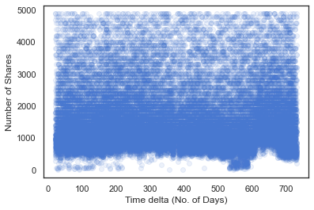
Notes:
So we plotted this scatter plot to see if there is any relationship. And like we assumed, there is none. Majority of the number of shares lie within the range 0-5000 (87% of the data) which is why I have filtered it till here.
And for the classification problem, we went ahead and caluclated the median of our dataset – which was 1400 and engineered another vraiable called target to classify each article as popular vs unpopular. This became our response variable. Why not mean? Because class imbalance.

Slide 8
Exploratory Data Analysis

Slide 9
1. Effect of Digital content on popularity
2 Digital Content features – Number of Videos and Number of Images
Distributions

Slide 10
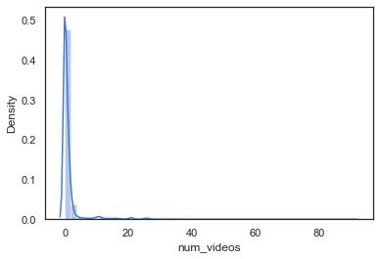
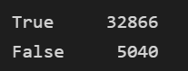
Notes:
High misbalance. 0 and 1 for majority of the data. The contingency table shows True = 0 or 1 and False > 1. Majority of the data contains 0 or 1.

Slide 11
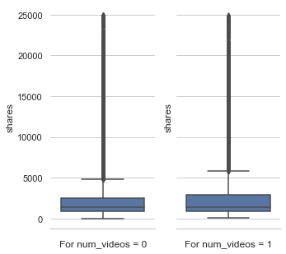
Notes:
Next, we wanted to analyze 0 and 1 in depth. We wanted to see whether having 0 videos or 1 video have any effect on popularity (number of shares). To do this we plotted boxplots.
From the above plot we see that the average of num_video = 0 and 1 is about the same. We can assume that having greater number of videos does not have a direct effect on number of shares.
Since shares value have many outliers and the mean is <5000 , I'm using the dataframe subset to having shares < 25000 for interpretability.

Slide 12
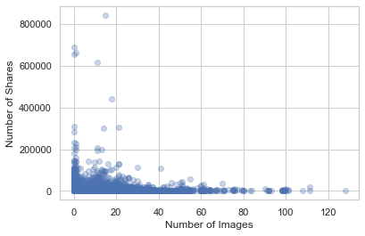
Notes:
We did the same for images and the results were similar. There was no direct effect of having more number of images on shares

Slide 13
2. No. Of Words to Popularity
2 features – Number of words in Content and Number of words in Title
Distributions

Slide 14
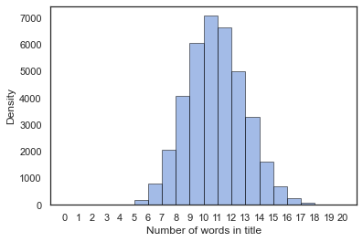
Notes:
n_token_titles seems to have a perfect normal distribution in the dataset with average value at around 10

Slide 15
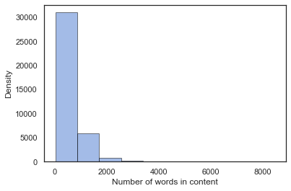
Notes:
Majority of the number of words tend to be concentrated < 2000. Subsetting and plotting this

Slide 16
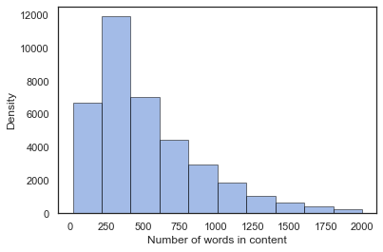
Notes:
When I looked at the value_counts of this, I could see around 1180 articles with 0 in number of contents. This EDA was important in removing this erroneous rows. When I checked the actual links of the articles, there were words in them so these rows were incorrect. We used this in preprocessing

Slide 17
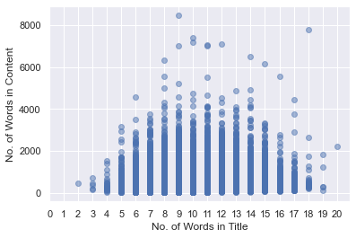
Notes:
Before plotting the relationship of these 2 features with number of shares, we wanted to see if there was a relationship between these 2 itself. So we plotted a scatter plot. It seems like, except for a few outliers, Number of words in the content peak when the Number of words in the title are between 8-14 and they fall off gradually as it increases or decreases from this range.

Slide 18
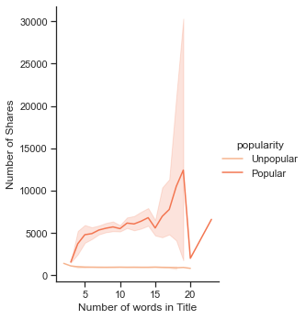
Notes:
So this is a relationship plot. The unpopular line is not of that much interest as the number of shares for unpopular remain constant. But with poplar articles, we see a constant increase in shares when the title increases and there is a sharp rise between 15-20. But decreases sharply once it is crossed.

Slide 19
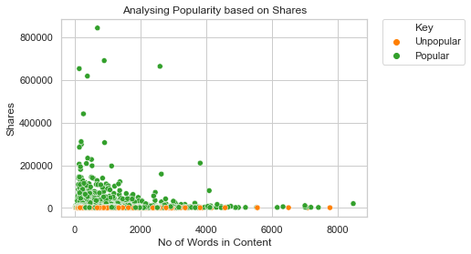
Notes:
With number of words in content, we don't really see a significant relationship with number of shares.

Slide 20
3. Day of Week effect on Popularity
Engineered feature that combines all Days of Week

Slide 21
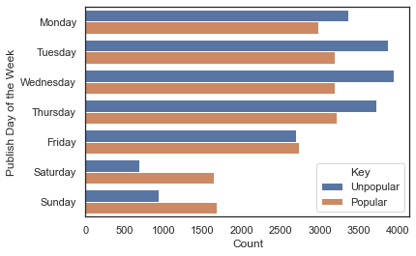
Notes:
This plot gives us highly useful insight. An article published over the weekend is more likely to be popular as opposed to an article that is published over the weekday. This makes intuitive sense since people have more time to read articles over the weekend as opposed to weekday. To showcase this, i'll plot the percentage chance of popularity on all weekdays according to our data.

Slide 22
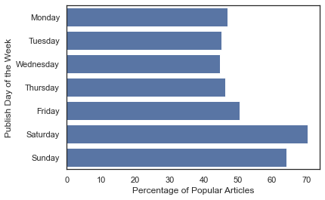
Notes:
We observe a trend. Near the weekends, the percentage of popular articles increases and peaks on Saturday, however, it gradually decreases then and is the lowest during mid-week on Wednesday.

Slide 23
4. Data Channel effect on Popularity
Engineered feature that combines all Data channels

Slide 24
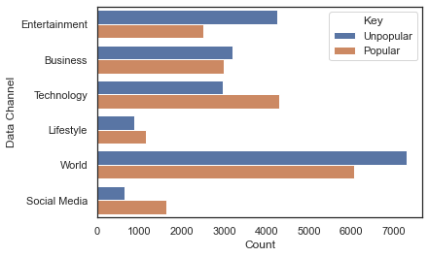
Notes:
We can observe that in category of technology and social media, the proportion of popular news is much larger than unpopular ones, and in category of world and entertainment, the proportion of unpopular news is larger than popular ones. This reflects that the readers of "Mashable.com" prefer the channel of technology and social media over the channel of world and entertainment.
We can plot the percentage of this like before to see comparison between popular and unpopular

Slide 25
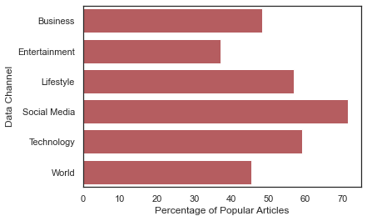
Notes:
Reinforces the previous observation

Slide 26
5. Title Sentiment effect on Popularity
Ranges from –1 to 1
Defines the orientation of expressed sentiment

Slide 27
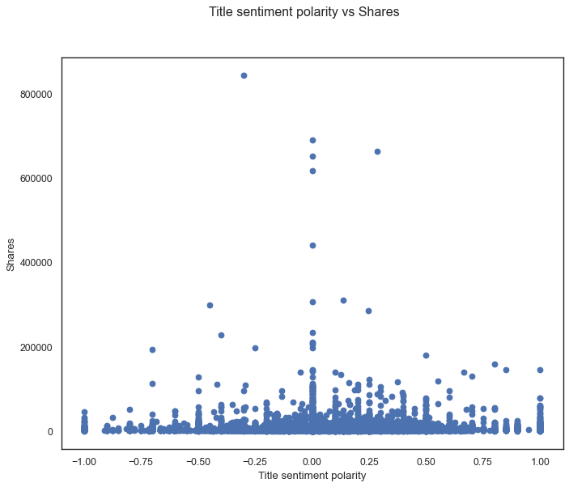
Notes:
Mostly the articles have titles which are not too positive or negative. It lies with in the range of -0.5 to 0.5. However highest concentration can be seen in the 0 axis i.e. high no. of articles are neutral in nature with higher number of shares.

Slide 28
6. Global subjectivity effect on Popularity
Ranges from 0 to 1
Defines the ratio of subjectivity to objectivity in the text

Slide 29
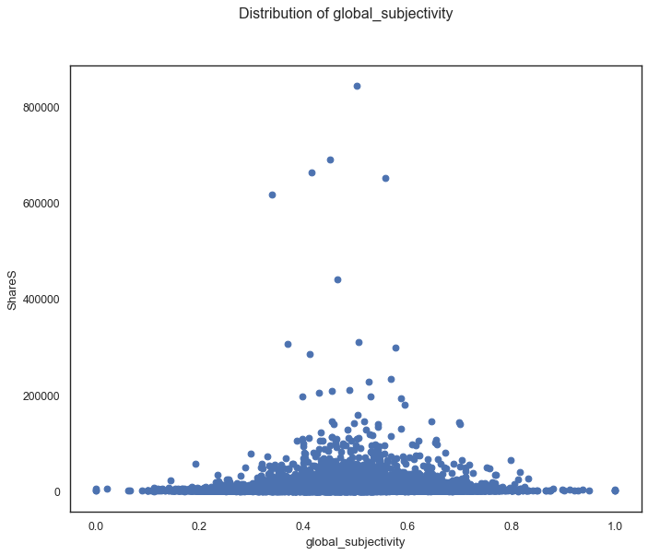
Notes:
Maximum of global_subjectivity lies between 0.3 to 0.7. Hence, we conclude that most of the articles with medium global_subjectivity have maximum shares, that is popular articles contain a good blend of personal opinions and factual information.

Slide 30
Preprocessing for Modeling

Slide 31
Pre-processing
Dropping duplicates
Dropping missing values
Subset – time_delta and words in content
Dropping irrelevant columns
Correlation heatmap – feature elimination
Notes:
Irrelevant columns like URL, timedelta
For the correlation heat map, we picked our threshold as 0.7 which seemed reasonable to remove variables that crossed this threshold. This helped avoid the problem of multicollinearity in the dataset.

Slide 32
Pre-processing
Outlier Treatment: Outliers clipped at
Q1 – 1.5 IQR and Q3 + 1.5 IQR
Imbalanced scale of features – Log or Standard Scaler?
Standard scaler adopted
Notes:
Irrelevant columns like URL, timedelta
For the correlation heat map, we picked our threshold as 0.7 which seemed reasonable to remove variables that crossed this threshold. This helped avoid the problem of multicollinearity in the dataset.
We picked Standard Scaler over Log scaling because we had a few features with negative values. We also wanted to preserve the distribution of the features and none of the remaining features had right skewness that needed treatment.

Slide 33
Modeling

Slide 34
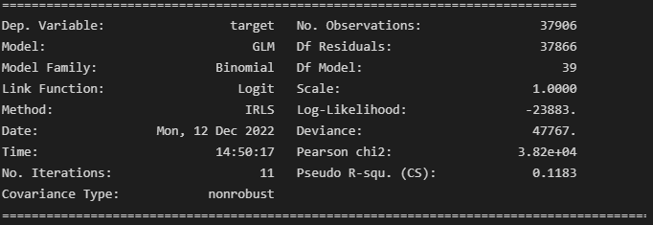
Stats library – Logit regression with all features

Slide 35
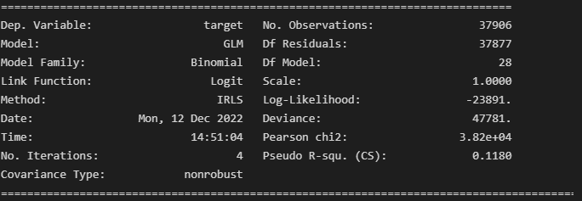
Stats library – Logit regression with only significant features

Slide 36
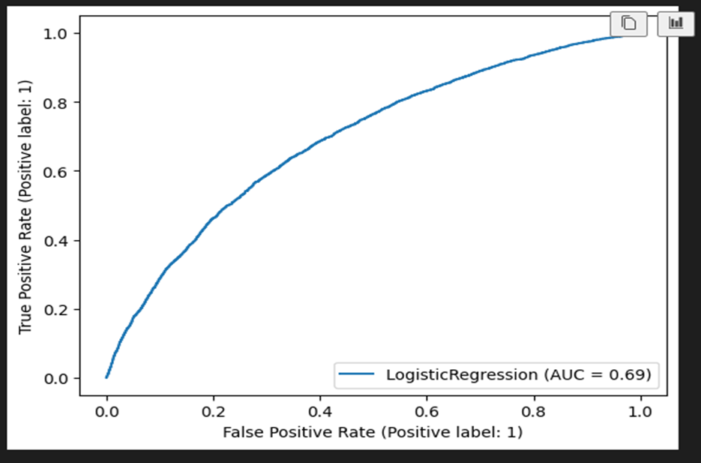
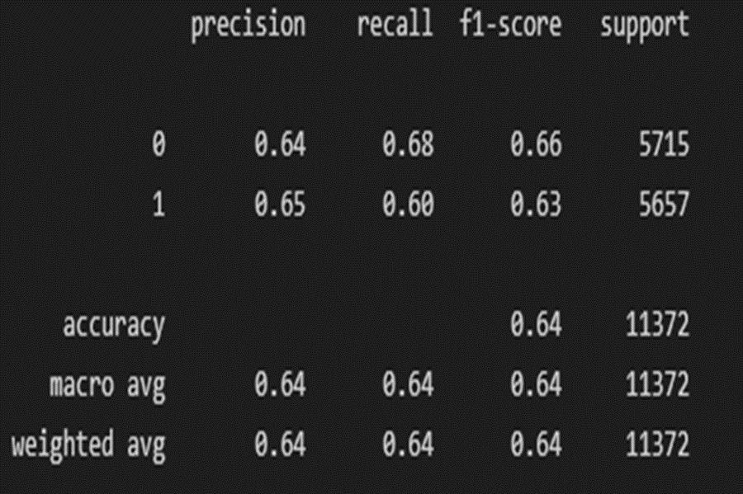
Logit Regression with Sklearn Library

Slide 37
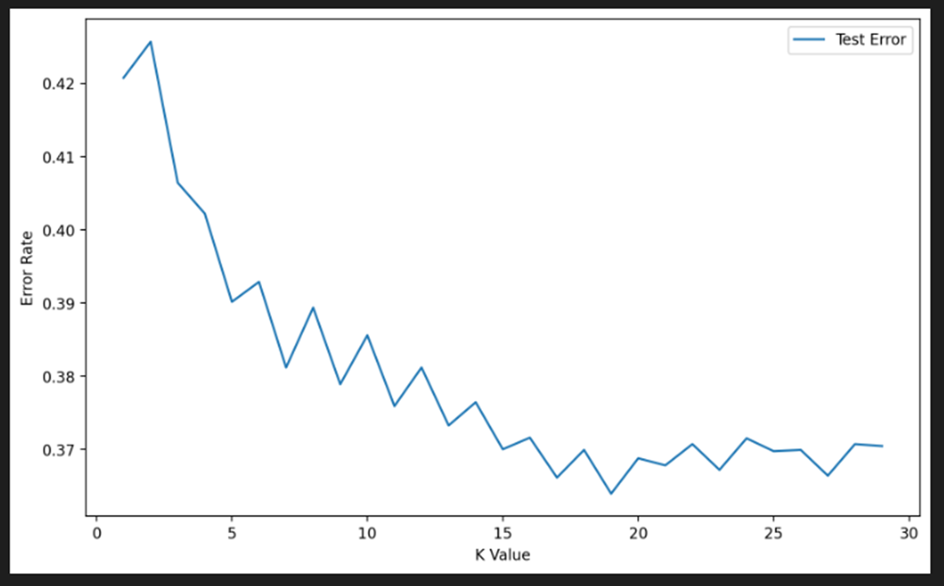
KNN
Choosing K value

Slide 38
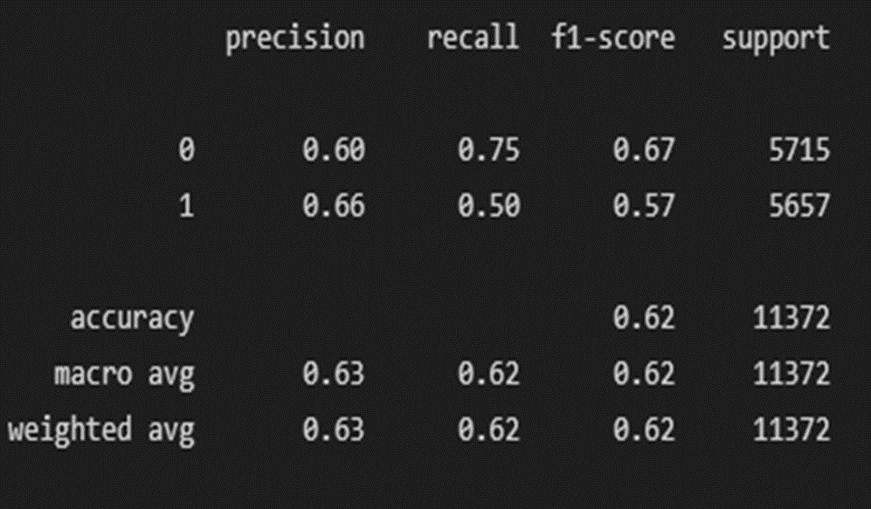
KNN
K = 17

Slide 39
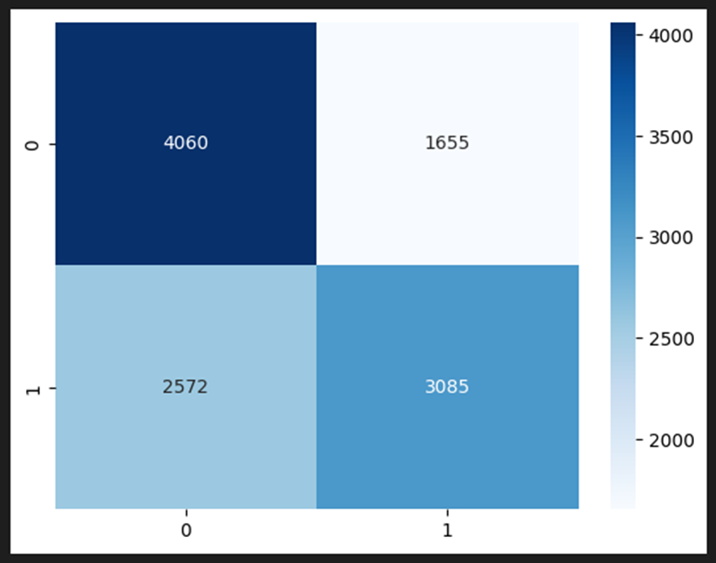
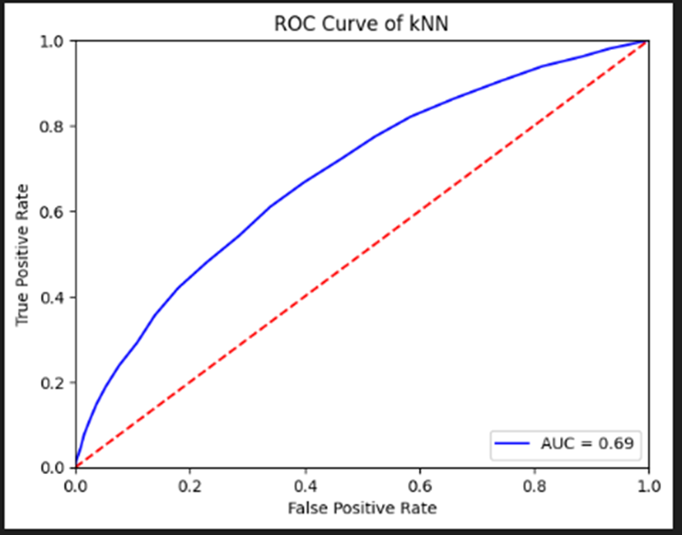
KNN - Confusion Matrix and ROC Curve

Slide 40
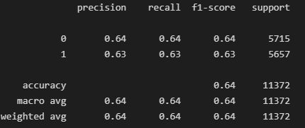
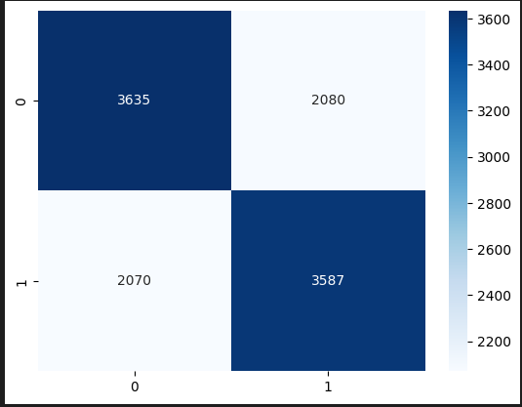
Decision Tree

Slide 41
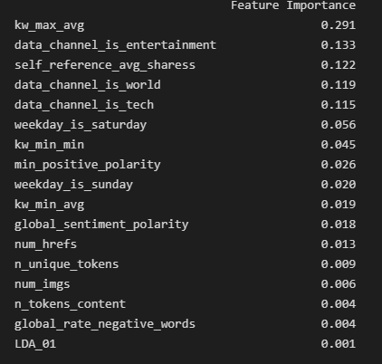
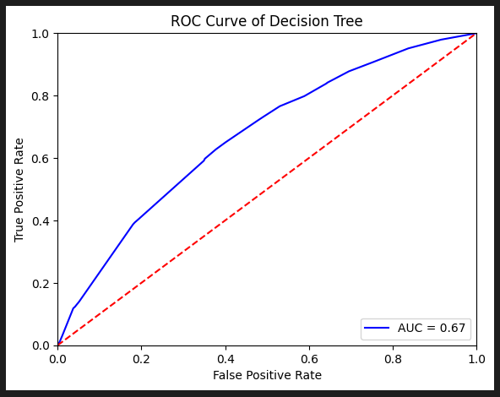
Feature Selection and ROC Curve

Slide 42
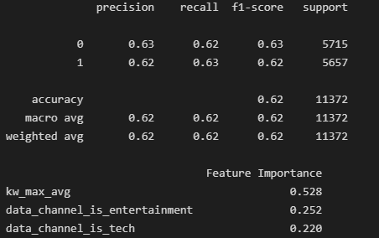
Pruning Decision Tree with features selection

Slide 43
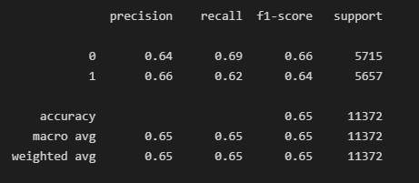
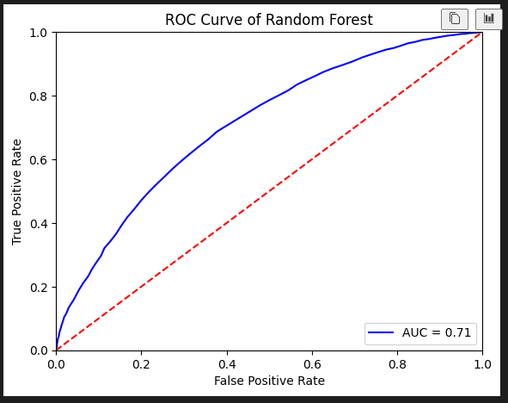
Random Forest

Slide 44
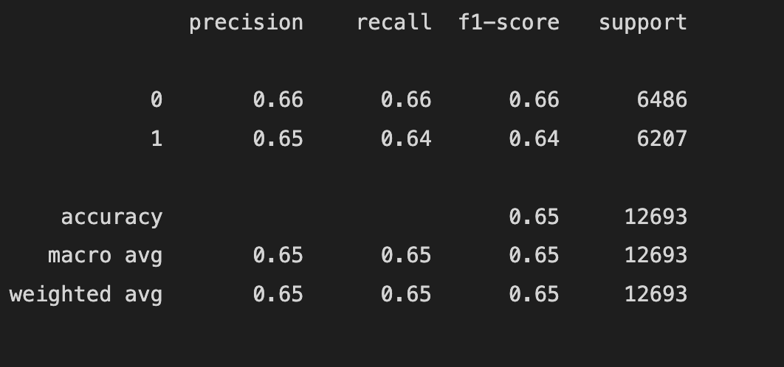
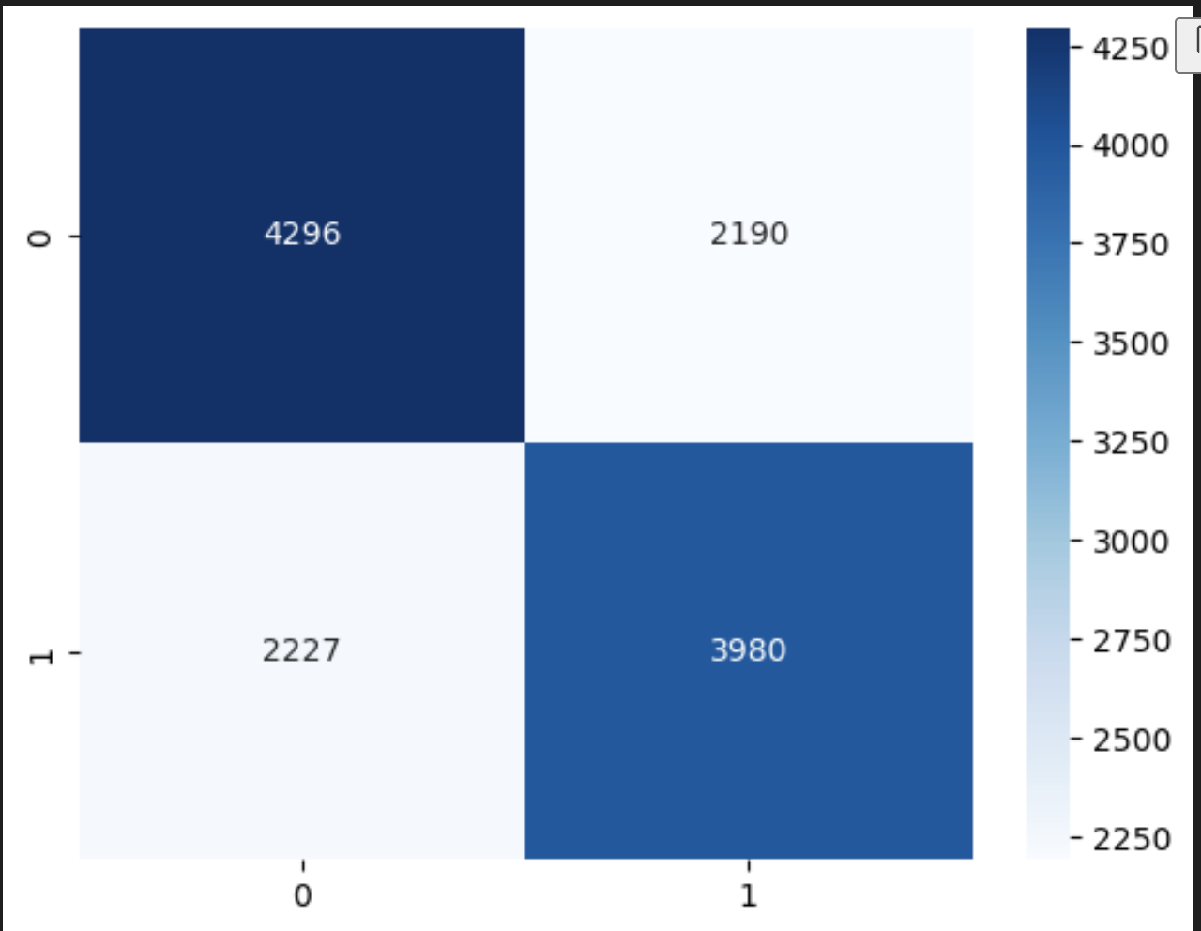
SVC

Slide 45
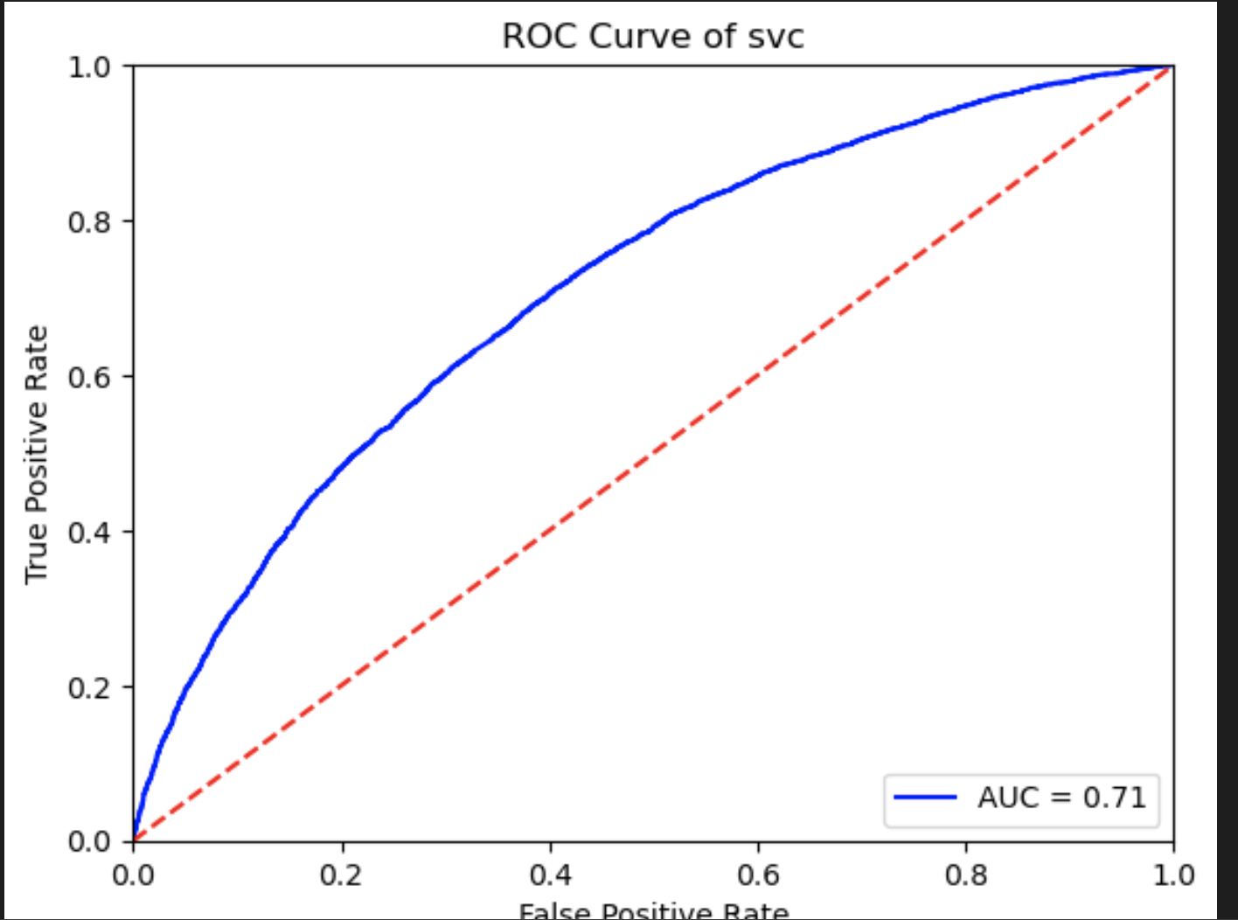
ROC curve for SVC

Slide 46
EDA Conclusions
Publishing article on Weekend – Higher shares
Publishing in Social Media and technology – Higher Shares
Balancing personal opinions with facts – Higher Shares
Remaining neutral towards Content – Higher Shares
Number of Words in title to be between 10 – 18, not too long; not too short.
Number of Words in content less than 0-2000. Short and catchy.

Slide 47
Model Conclusions
Random Forest and SVC gave the best results out of all the models in terms of accuracy.
The AUC for Random Forest and SVC was also the highest – 0.71, 21% greater than chance.

